Slide 1


Self-check 4
Look back 4
UNIT 4

Slide 2
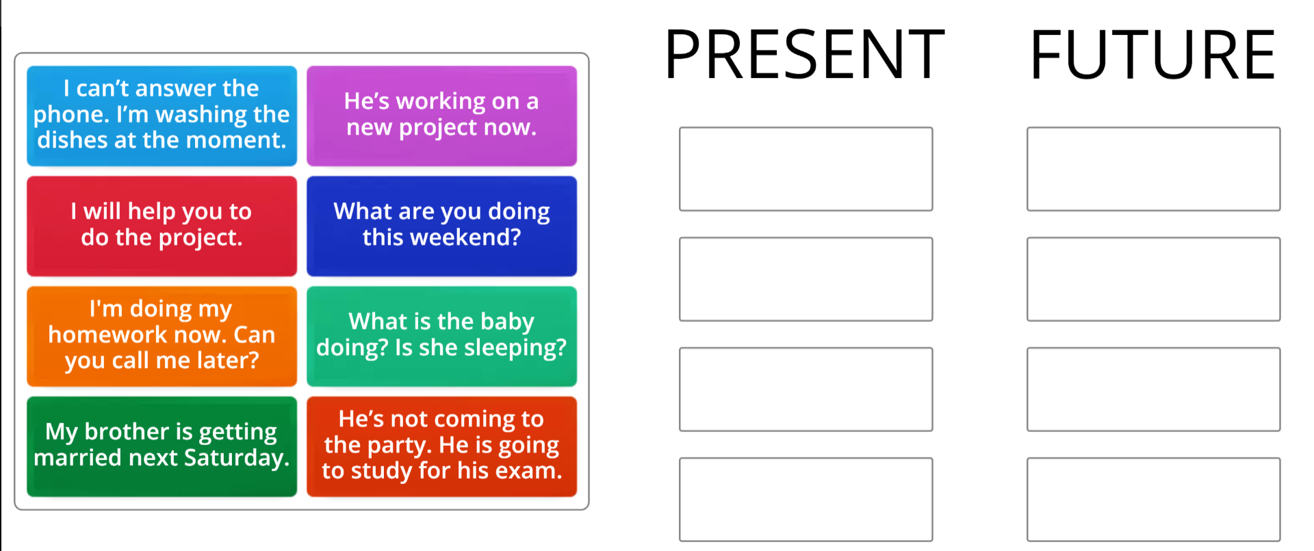
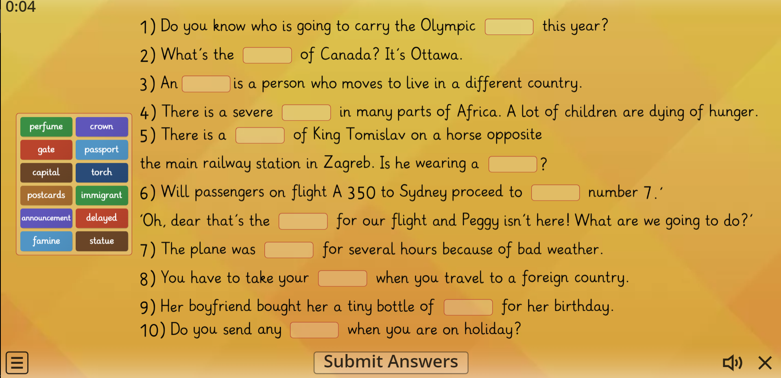
Drag and drop each item into its correct group.
https://wordwall.net/play/14755/453/570
Vocabulary time!
Drag and drop words into blank spaces.
https://wordwall.net/play/11682/826/604

Slide 3
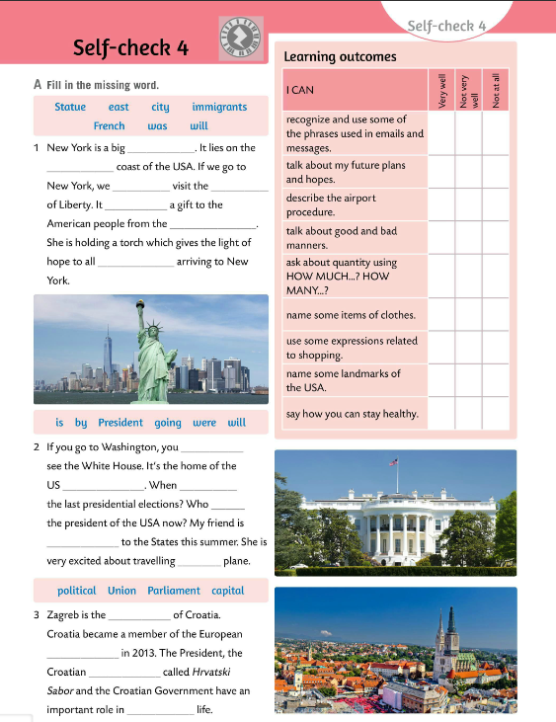
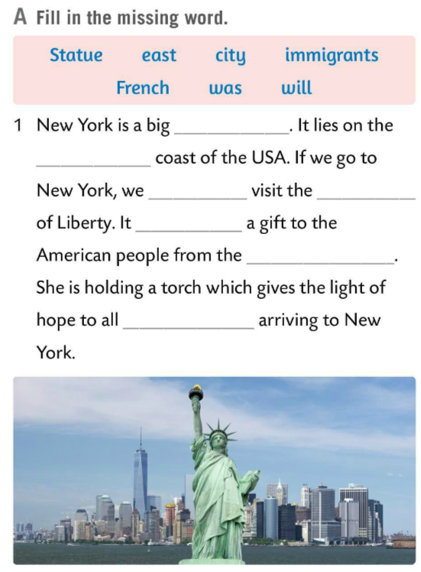
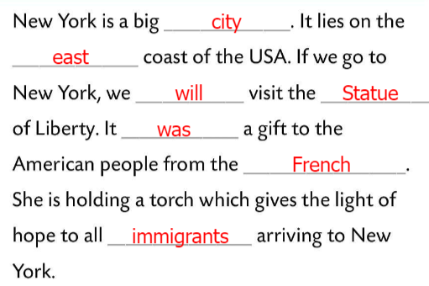
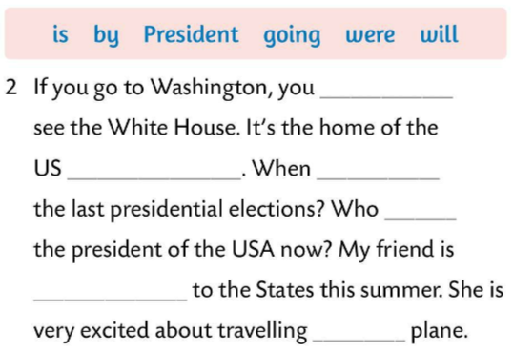
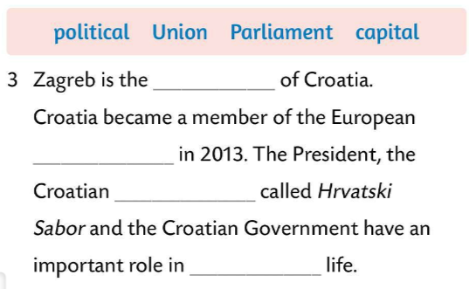
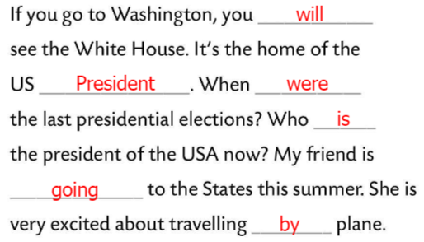
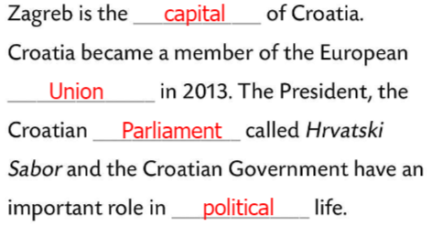
Fill in the missing word in Task A.
Check.

Slide 4
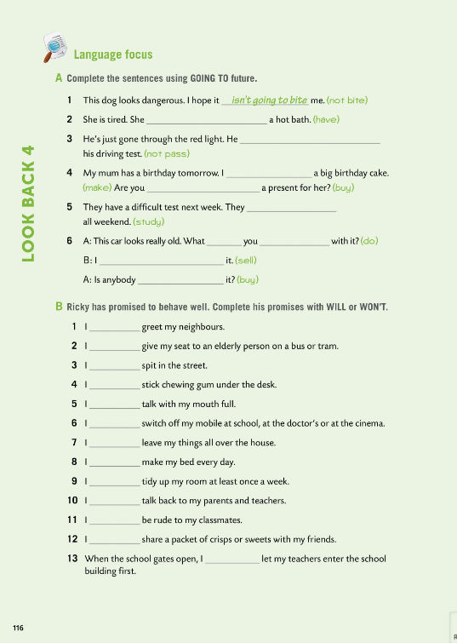

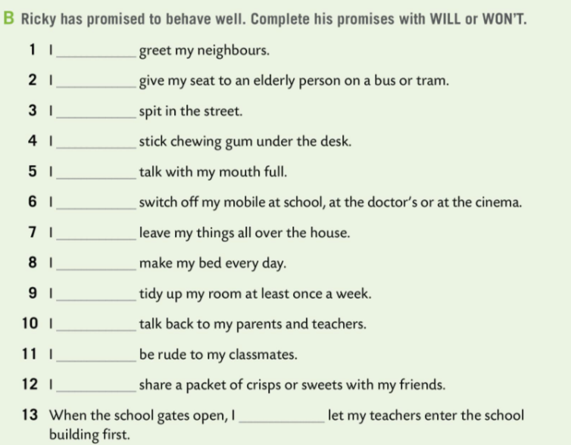
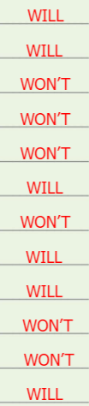

Workbook, page 116. LOOK BACK 4
Ricky has promised to behave well. Complete his promises with WILL or WON’T in Task B.
Check.

Slide 5
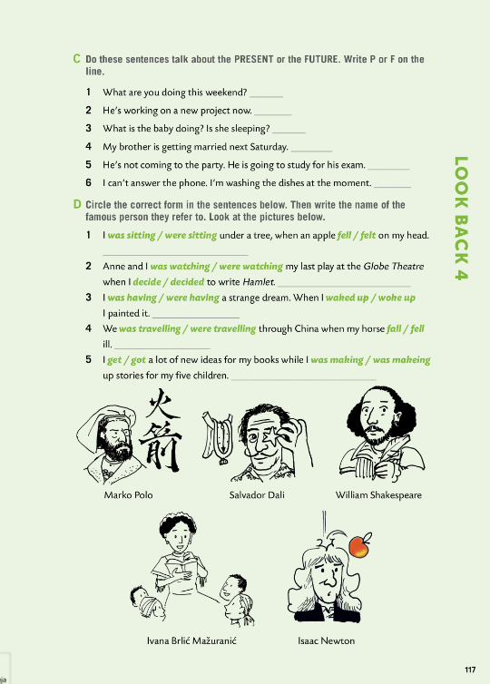
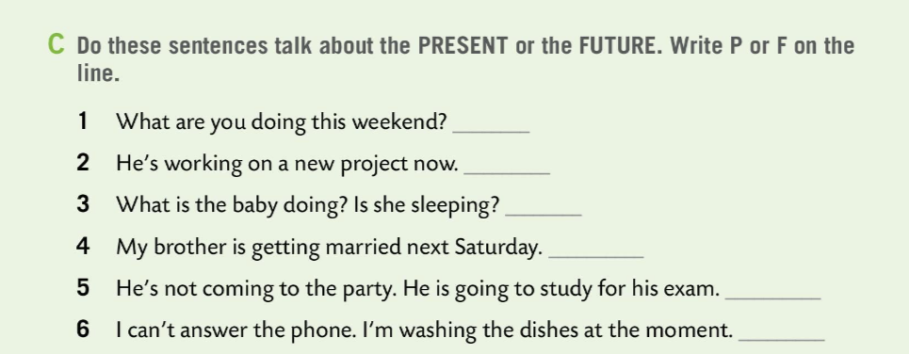
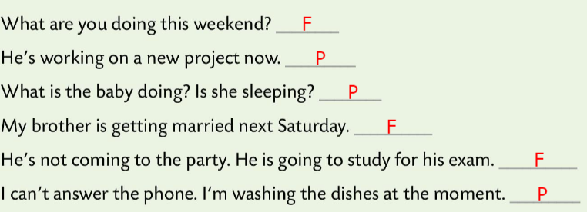
Workbook, page 117. LOOK BACK 4
Do sentences in Task C talk about the PRESENT (P) or the FUTURE (F)?
Write P or F on the line.
Check.

Slide 6
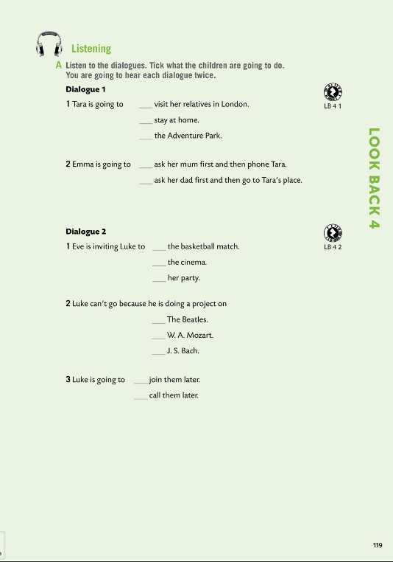
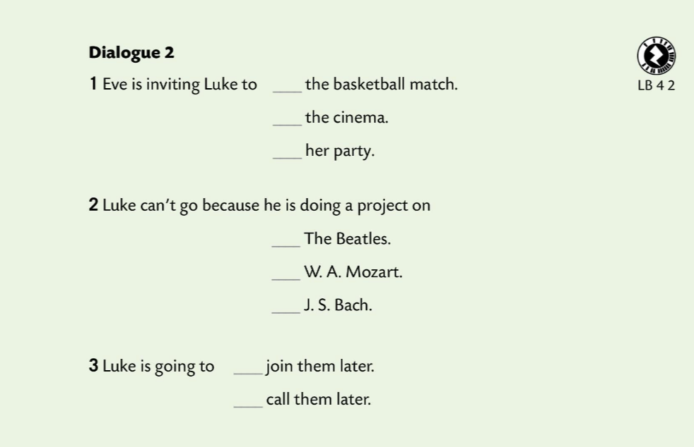
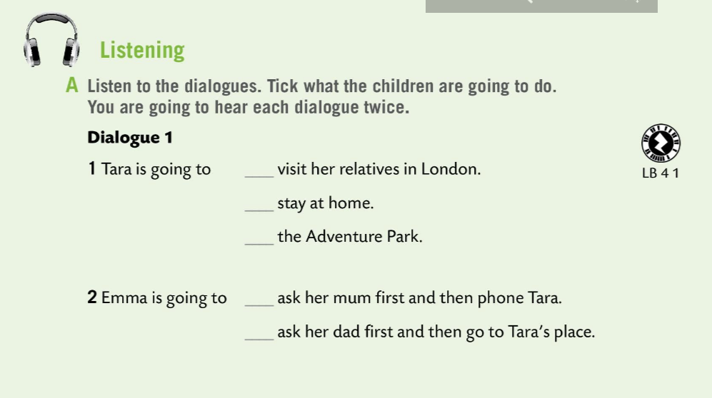


Workbook, page 119. LOOK BACK 4
Listen to the dialogues.
Tick what the children are going to do.
Dialogue 1.
Check.
Dialogue 2.
Check.

Slide 7
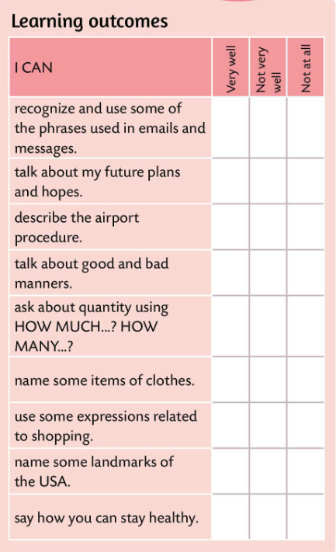
Look at the learning outcomes table.
Which of the outcomes did you master very well?
Which ones need more improvement?
Do you need more time and practice for any of them?
Be honest.

